Slide 1
Python for beginners
Shuba Iyer and Shriya Kurpad

Slide 2
Python Shell
It is the Interactive Window where
You can type one Python Statement at a time
See the results of your statement Right away
The 3 greater-than signs ( >>> ) are called Prompt

Slide 3
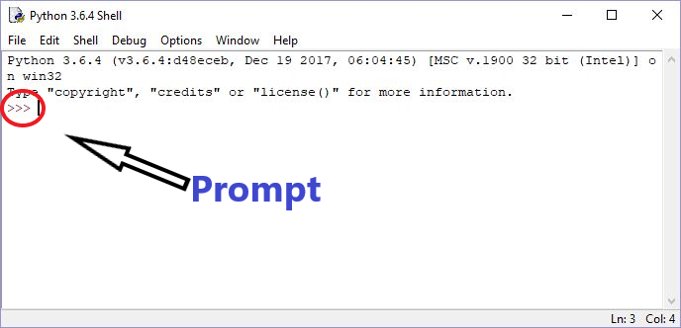
Python Integrated Development and Learning Environment (IDLE)

Slide 4
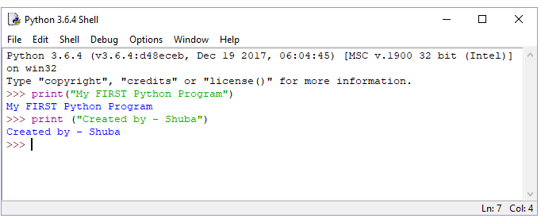
Your very first Python Program

Slide 5
Saving your Python code
Do you want to
Avoid rewriting code
Print and reference your code
How do we do it?
The answer: Python Script
To save a new program, in IDLE (Shell)
Choose File -> New File
An empty window will appear with Untitled on the Menu Bar
Enter your Python code. Eg: print (“Hello World”)
Now choose File -> Save
Save it on your USB drive with a name, say, hello.py
File extension

Slide 6
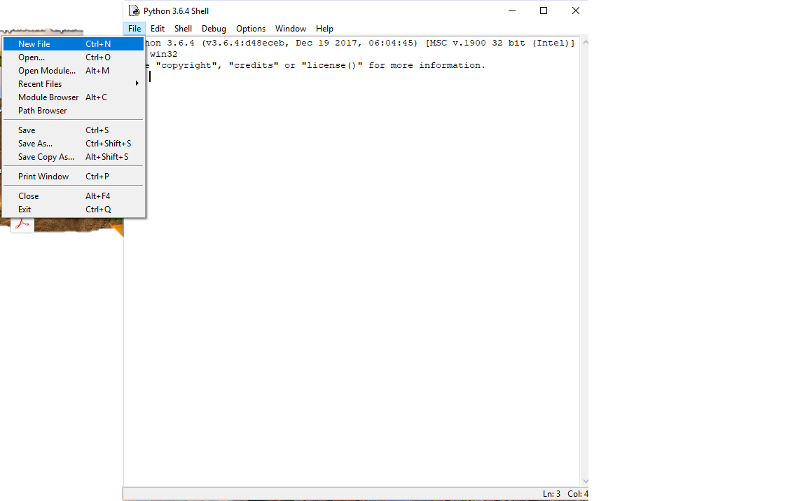
Python Script

Slide 7
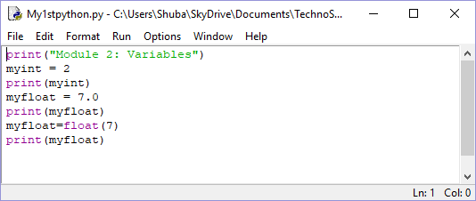
Simple Python script
Each line is a Python statement
In the shell window, type each statement and hit enter
Don’t forget the parentheses for the “print” statement
See what happens if you do not use parentheses

Slide 8
Magic Coins
Found 20 Gold coins when you were digging around in your backyard
You pace the 20 Gold coins in a “Magic Box”
The Magic Box adds 10 gold coins everyday of the year
How many coins would you have in the treasure chest if you did this everyday for one year?
10 X 365 = 3650
20 + 3650 - 3670

Slide 9
Python operators
+ Addition
- Subtraction
* Multiplication
/ Division
>>> 10 * 365
>>> 3650
>>> 20 + 3650
>>> 3670
>>> 20 + (10 * 365)
>>> 3670
What is?
((5 + 30) * 20) / 10

Slide 10
On your own-----
More operators:
divide: /
multiply: *
Try doing some math at the prompt:
>>> 6 * 5
>>> 6 / 2
>>> 10 * 5 * 3
Try doing some math at the prompt:
>>> 1 + 2
>>> 12 - 3
>>> 9 + 5 - 15
Operators:
add: +
subtract: -
-

Slide 11
Variables
Variables are like labels
>>> fred = 200
>>> print (fred)
>>> 200
Another example
>>> fred = 200
>>> john = fred
>>> print (john)
>>> 200

Slide 12
Magic Coins – Python Script
found_coins = 20 ← (What you found in the backyard)
magic_coins = 10 ← (Magic coins that Magic box gives)
stolen_coins = 3 ← (Crow steals)
loot = found_coins + (magic_coins * 365) ← (total at the end of the year)
stolen_by_crow = stolen_coins * 365 ← (total stolen by the crow)
loot = loot – stolen_by_crow ← (final loot!)

Slide 13
Recap
Review of IDLE, Shell, Script
Math operations
Variables

